Slide 1
Instruction Set Architecture (ISA)
Principles and Example
指令系统原理与实例

Slide 2
Outline
Introduction
Classifying instruction set architectures
Instruction Characteristics
  Memory addressing
  Type and size of operands
  Operations in the instruction set
  Instructions for control flow
  Encoding an instruction set
The Role of compilers
The MIPS architecture

Slide 3
Brief Introduction to ISA
Instruction Set Architecture:
a set of instructions
  Each instruction is directly executed by the CPU’s hardware
How is it represented?
  By a binary format since the hardware understands only bits
    Concatenate(连接) together binary encoding for instructions, registers, constants, memories
Notes:
表示？

Slide 4
Brief Introduction to ISA (cont.)
Options - fixed or variable length formats
  Fixed - each instruction encoded in same size field (typically 1 word)
  Variable – half-word, whole-word, multiple word instructions are possible
Typical physical blobs are bits, bytes, words, n-words
Word size is typically 16, 32, 64 bits today
Notes:
物理块

Slide 5
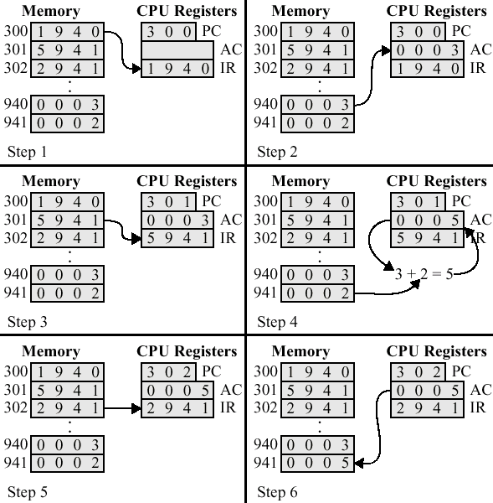
An Example of Program Execution
Command
  Load AC from Memory
  Add to AC from memory
  Store AC to memory
Add the contents of memory 940 to the content of memory 941 and stores the result at 941
Fetch
Execution

Slide 6
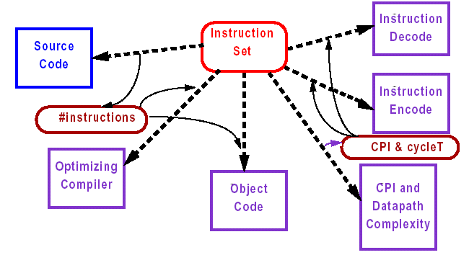
Instruction Set Design
The instruction set influences everything

Slide 7
Characteristics of
Instruction Set

Slide 8
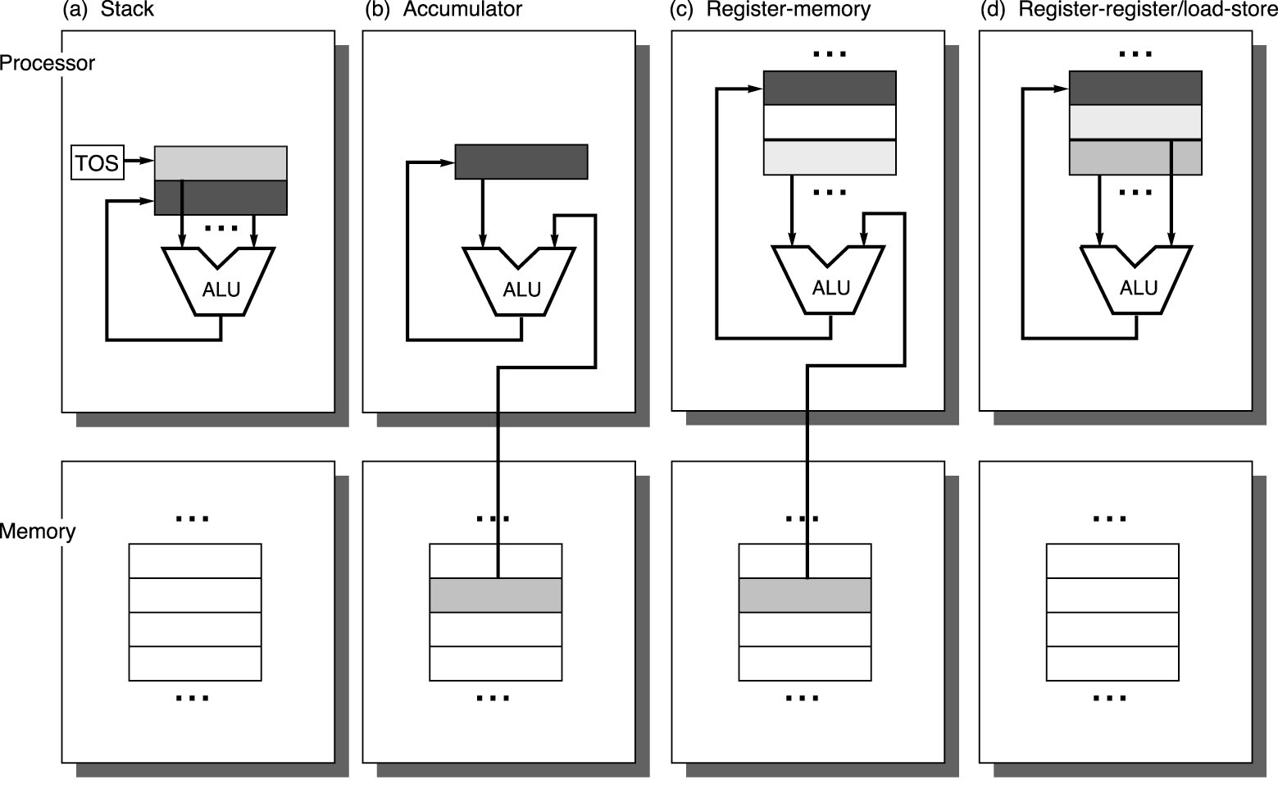
Classifying Instruction Set Architectures
By the type of internal storage in a processor(CPU内部存储类型)
Processor
Memory

Slide 9
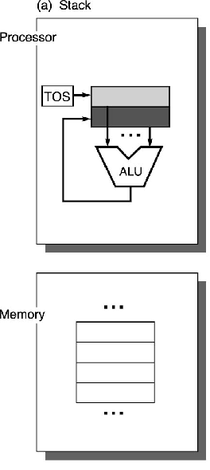
By the Type of Internal Storage - Stack
Push A
Push B
Add
Pop C
C=A+B
A,B,C In Memory

Slide 10
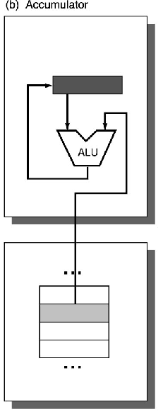
By the Type of Internal Storage – Accumulator(累加器)
Load A
Add B
Store C
累加器为算术逻辑单元(ALU)提供一个操作数，并用来保存操作的结果
C=A+B
A,B,C In Memory
Notes:
累加寄存器简称累加器。从图3-1可以看出，它的信息来源于缓冲寄存器或算术逻辑单元(ALU)，它的数据出口是算术逻辑单元(ALU)。因此，累加器为算术逻辑单元(ALU)提供一个操作数，并用来保存操作的结果。算术逻辑单元最基本的操作是加法，这就是累加器名称的由来。显然，在一个算术逻辑单元中，至少有一个累加器。

Slide 11
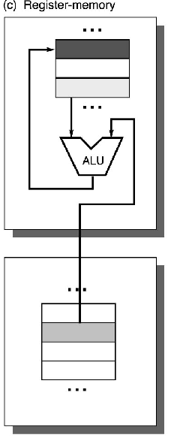
By the Type of Internal Storage – Register-Memory
Load R1, A
Add R3, R1, B
Store R3, C
C=A+B
A,B,C In Memory

Slide 12
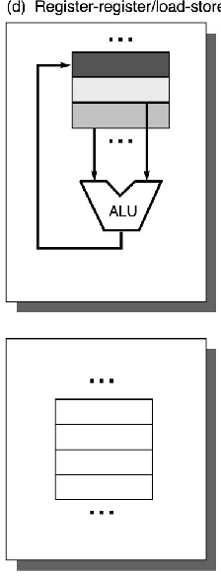
By the Type of Internal Storage – Register (load-store)
Load R1, A
Load R2, B
Add R3, R1, R2
Store R3, C
C=A+B
A,B,C In Memory

Slide 13
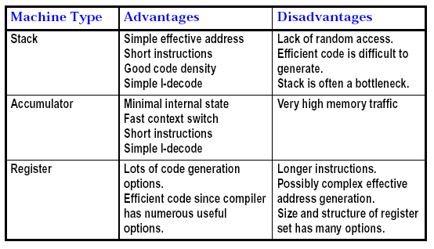
Pro’s and Con’s of Stack, Accumulator, Register Machine

Slide 14
三种类型指令集结构的优缺点
指令集结构类型
优 点
缺 点
堆栈型
是一种表示计算的简单模型；指令短小。
堆栈不能被随机访问，从而很难生成有效代码。同时，由于堆栈是瓶颈，所以很难被高效地实现。
累加器型
减小了机器的内部状态；指令短小。
由于累加器是唯一的暂存器，这种机器的存储器通信开销最大。
寄存器型
是代码生成最一般的模型。
所有操作数均需命名，且显式表示，因而指令比较长。

Slide 15
Classifying Instruction Set Architectures (cont.)
A load-store architecture survived because
  Registers are faster than memory
  Registers are more efficient for a compiler to use
    (A * B) – (B * C) – (A * D) -> evaluated in any order 任意顺序执行（否则要考虑取存位置和顺序）
    Hold variables 存放变量，减少数据流量，加速程序运行，提高代码密度（指明一个寄存器的位数比指明一个存储器地址要少）
Notes:
提高代码密度：指明一个寄存器的位数比指明一个存储器地址要少。
寄存器分类：1）表达式计算 2）传递参数 3）存放变量

Slide 16
Instruction Set Characteristics of General-Purpose Register (GPR) Architectures
GPR系统结构由指令集两个特性来划分：
Whether an ALU instruction has two or three operands
  In the three-operand format, the instruction contains one result operand and two source operands
  In the two-operand format, one of the operands is both a source and a result for the operation
How many of the operands may be memory addresses in ALU instructions（在ALU指令中，有多少个操作数可以用存储器来寻址，也即有多少个存储器操作数？ ）

Slide 17
Combinations of
Number of Memory Addresses and Operands Allowed
Number of memory address | Maximum number of operands allowed | Types of architecture | Examples
0 | 2 / 3 | Register-register | Alpha, ARM, MIPS, PowerPC, SPARC, SuperH, Trimedia TM5200
1 | 2 / 3 | Register-memory | IBM 360/370, Intel 80x86, Motorola 68000, TI TMS320C54x
2 | 2 / 3 | Memory-memory | VAX
3 | 3 | Memory-memory | VAX
Although there are seven possible combinations, three serve to classify nearly all existing computers.
Notes:
ALU指令中，存储器操作数个数和操作数个数的所有可能组合，以及相应的机器实例。
两个特性的结合。7种组合（不可能出现3，2）。

Slide 18
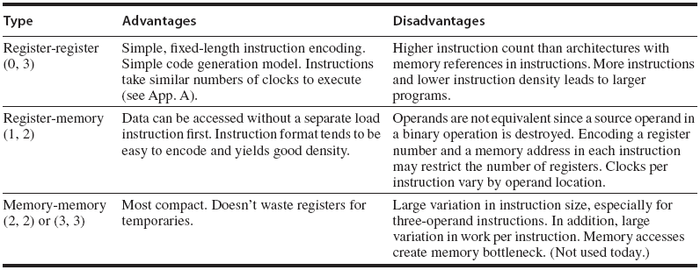
Compare Three Common General -Purpose Register Computers
where (m,n) means m memory operands and n total operands

Slide 19
指令集结构类型
优 点
缺 点
寄存器－寄存器型
（0,3）
简单，指令字长固定，是一种简单的代码生成模型，各种指令的执行时钟周期数相近。
和指令中含有对存储器操作数访问的结构相比，指令条数多，因而其目标代码较大。
寄存器－存储器型
（1,2）
可以直接对存储器操作数进行访问，容易对指令进行编码，且其目标代码较小。
指令中的操作数类型不同。在一条指令中同时对一个寄存器操作数和存储器操作数进行编码，将限制指令所能够表示的寄存器个数。由于指令的操作数可以存储在不同类型的存储器单元，所以每条指令的执行时钟周期数也不尽相同。
存储器－存储器型(2,2)或（3,3）
是一种最紧密的编码方式，无需“浪费”寄存器保存变量。
指令字长多种多样。每条指令的执行时钟周期数也大不一样，对存储器的频繁访问将导致存储器访问瓶颈问题。

Slide 20
Instruction Characteristics
Memory Addressing
Type and Size of Operands
Operations in the Instruction Set
Instructions for Control Flow
Encoding an Instruction Set

Slide 21
1. Memory Addressing

Slide 22
Memory Addressing
How memory addresses are interpreted
  Endian order 端序/字节序
  Alignment 大于一个字节的数据的寻址必须对齐
How architectures specify the address of an object they will access
  Addressing modes 寻址模式
Notes:
解释

Slide 23
Memory Addressing (cont.)
All instruction sets discussed in this book are byte addressed
The instruction sets provide access for bytes (8 bits), half words (16 bits), words (32 bits), and even double words (64 bits)
Two conventions for ordering the bytes within a larger object
  Little Endian
  Big Endian
Notes:
约定

Slide 24
Little Endian
The low-order byte of an object is stored in memory at the lowest address, and the high-order byte at the highest address. (The little end comes first.)
For example, a 4-byte object
  (Byte3 Byte2 Byte1 Byte0)
  Base Address+0 Byte0
  Base Address+1 Byte1
  Base Address+2 Byte2
  Base Address+3 Byte3
Intel processors (those used in PC's) use "Little Endian" byte order.
0x0304
00 01
0x04
0x03
Dr. William T. Verts An Essay on Endian Order, http://www.cs.umass.edu/~verts/cs32/endian.html, April 19, 1996
Notes:
0x0304=772

Slide 25
Big Endian
The high-order byte of an object is stored in memory at the lowest address, and the low-order byte at the highest address. (The big end comes first.) 网络字节序
For example, a 4-byte object
  (Byte3 Byte2 Byte1 Byte0)
  Base Address+0 Byte3
  Base Address+1 Byte2
  Base Address+2 Byte1
  Base Address+3 Byte0
0x0304
00 01
0x03
0x04
把给定系统所采用的字节序称为主机字节序。为了避免不同类别主机之间在数据交换时由于对于字节序解释的不同而导致的差错，引入了网络传输所采用的字节序，即网络字节序。规定网络字节序使用“Big-Endian”方式。
Dr. William T. Verts An Essay on Endian Order, http://www.cs.umass.edu/~verts/cs32/endian.html, April 19, 1996

Slide 26
Endian Order is Also Important to File Data
Adobe Photoshop -- Big Endian
BMP (Windows and OS/2 Bitmaps) -- Little Endian
DXF (AutoCad) -- Variable
GIF -- Little Endian
JPEG -- Big Endian
PostScript -- Not Applicable (text!)
Microsoft RIFF (.WAV & .AVI) -- Both, Endian identifier encoded into file
Microsoft RTF (Rich Text Format) -- Little Endian
TIFF -- Both, Endian identifier encoded into file
Dr. William T. Verts An Essay on Endian Order, http://www.cs.umass.edu/~verts/cs32/endian.html, April 19, 1996

Slide 27
Memory Addressing (cont.)
Alignment restrictions 对齐限制
  Accesses to objects larger than a byte must be aligned
  An access to an object of size s bytes at byte address A is aligned if A mod s = 0
  A misaligned access takes multiple aligned memory references
Notes:
MOD 取余数

Slide 28
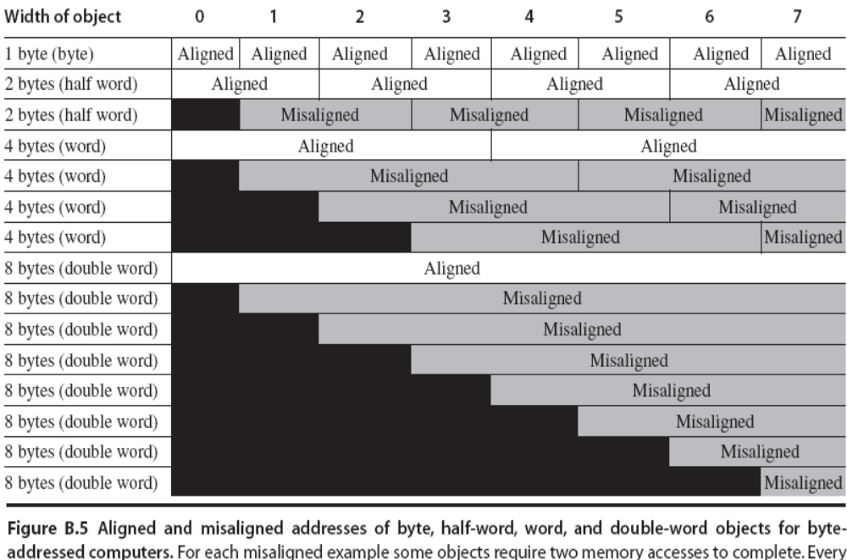

Slide 29
Addressing Modes 寻址模式
Addressing modes can significantly reduce instruction counts but add the complexity of building a computer and may increase the average CPI
How architectures specify the address of an object they will access?
  Constants
  Register
  Locations in memory

Slide 30
Example for Addressing Modes
Addressing mode | Example instruction | Meaning | When used
Register | Add R4,R3 | Regs[R4] <- Regs[R4] + Regs[R3] | When a value is in a register
Immediate | Add R4,#3 | Regs[R4] <- Regs[R4] + 3 | For constants
Displacement 位移（变址）寻址 | Add R4,100(R1) | Regs[R4] <- Regs[R4] + Mem[100 + Regs[R1]] | Accessing local variables (+ simulates register redirect, direct addressing modes)
Register indirect 间接寻址 | Add R4, (R1) | Regs[R4] <- Regs[R4] + Mem[Regs[R1]] | Accessing using a pointer or a computed address

Slide 31
Example for Addressing Modes (cont.)
Addressing mode | Example instruction | Meaning | When used
Indexed 索引（基址）寻址 | Add R3,(R1+R2) | Regs[R3] <- Regs[R3] + Mem[Regs[R1] + Regs[R2]] | Sometimes useful in array addressing: R1 = base of array; R2= index amount
Direct or absolute 直接/绝对寻址 | Add R1,(1001) | Regs[R1] <- Regs[R1] + Mem[1001] | Sometimes useful for accessing static data; address constant may need to be large
Memory indirect 存储器间接寻址 | Add R1,@(R3) | Regs[R1] <- Regs[R1] + Mem[Mem[Regs[R3]]] | If R3 is the address of a pointer p, the mode yields *p

Slide 32
Example for Addressing Modes (cont.)
Addressing mode | Example instruction | Meaning | When used
Autoincrement | Add R1,(R2)+ | Regs[R1] <- Regs[R1] + Mem[Regs[R2]] Regs[R2] <- Regs[R2] + d | Useful for stepping through arrays within a loop. R2 points to start of array; each reference increments R2 by size of an element, d
Autodecrement | Add R1,-(R2) | Regs[R2] <- Regs[R2] – d Regs[R1] <- Regs[R1] + Mem[Regs[R2]] | Same use as autoincrement. Autodecrement/-increment can also act as push/pop to implement a stack
Scaled 比例寻址 | Add R1,100(R2)[R3] | Regs[R1] <- Regs[R1] + Mem[100 + Regs[R2] + Regs[R3] * d] | Used to index arrays. May be applied to any indexed addressing mode in some computers

Slide 33
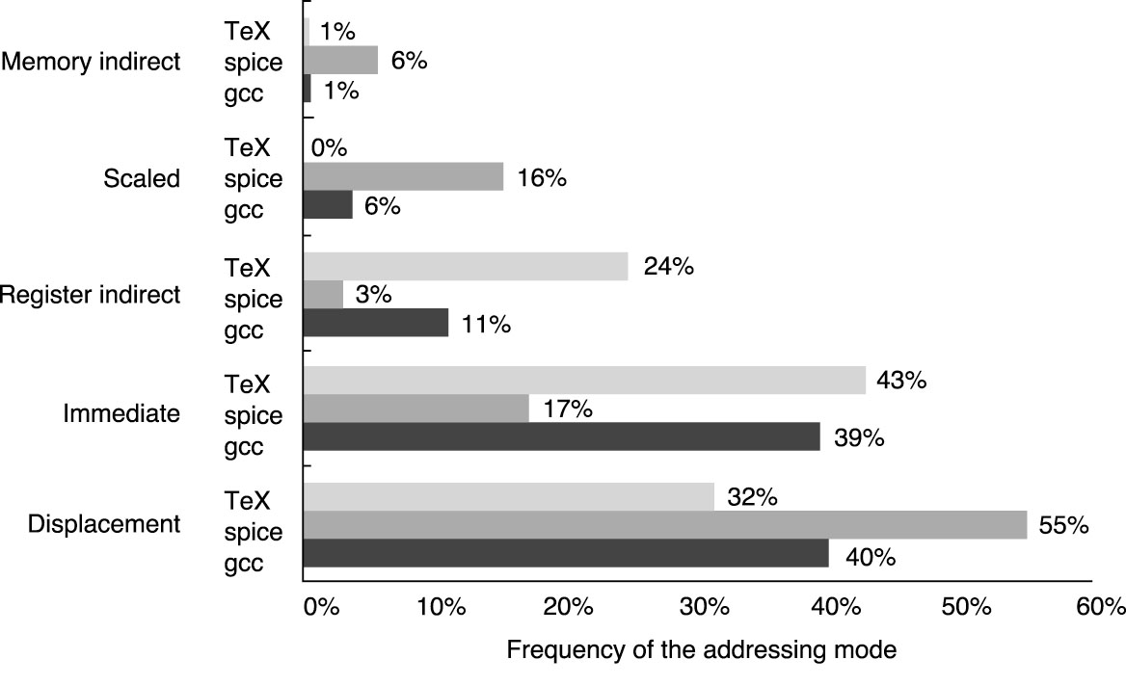
Summary of Use of Memory Addressing Mode
displacement, immediate, and register indirect addressing modes represent 75% to 99% of the addressing mode usage
For VAX architecture
Notes:
C编译程序、 Tex 正文处理软件、CAD工具Spice

Slide 34
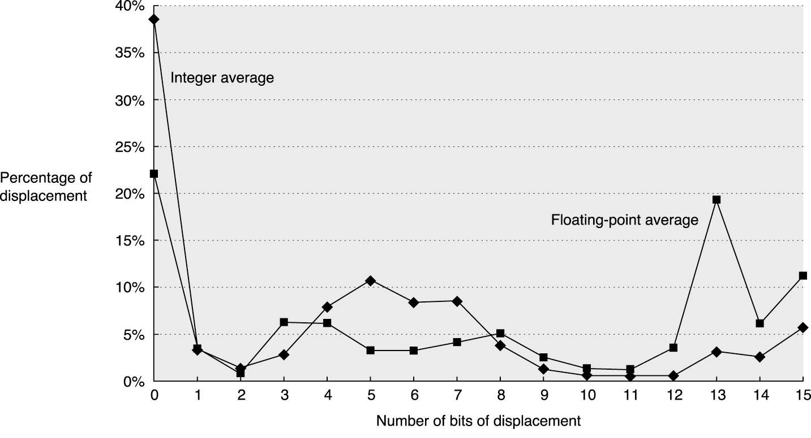
Displacement Addressing Mode
What’s an appropriate range of the displacements? 位移的范围
The size of address should be at least 12-16 bits, which capture 75% to 99% of the displacements
For Alpha architecture
Notes:
不同测试程序的数据存取的测试结果。X轴，位移范围所需域的大小；Y轴，需要位移的百分比。
SPECint,SPECfp92

Slide 35
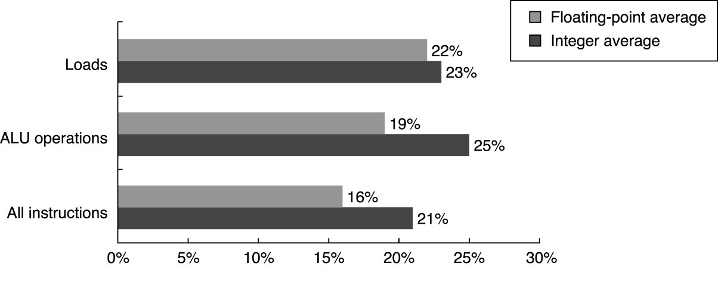
Immediate or Literal Addressing Mode 立即数或文字寻址
Does the mode need to be supported for all operations or for only a subset?
使用立即数操作的百分比

Slide 36
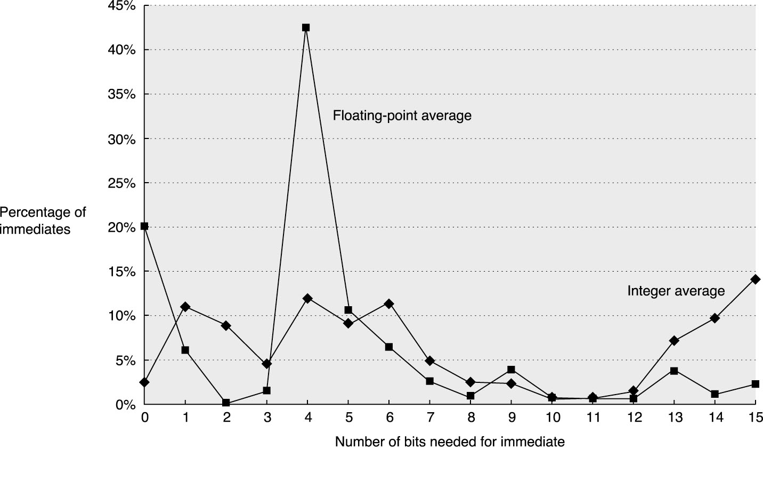
Immediate Addressing Mode (cont.)
What’s a suitable range of values for immediates?
The size of the immediate field should be at least 8-16 bits, which capture 50% to 80% of the immediates.
For Alpha architecture

Slide 37
Summary: Memory Addressing
First, because of their popularity, we would expect a new architecture to support at least the following addressing modes: displacement, immediate, and register indirect.
Second, we would expect the size of the address for displacement mode to be at least 12–16 bits, since these sizes would capture 75% to 99% of the displacements.
Third, we would expect the size of the immediate field to be at least 8–16 bits.

Slide 38
2. Type and Size of Operands

Slide 39
Type and Size of Operands
How is the type of an operand designated
(指定，标明)?
  Encoding in the opcode
    For an instruction, the operation is typically specified in one field, called the opcode
  By tag (not used currently)
Common operand types
  Character
    8-bit ASCII
    16-bit Unicode 可以容纳世界上所有文字和符号的字符编码方案
Notes:
Unicode是国际组织制定的可以容纳世界上所有文字和符号的字符编码方案。

Slide 40
Common Operand Types (cont.)
  Integer
    One-word 2’s complement 二进制补码
  Single-precision floating point
    One-word IEEE 754
  Double-precision floating point
    2-word IEEE 754
  Packed decimal (binary-coded decimal)
    4 bits encode the values 0-9
    2 decimal digits are packed into one byte

Slide 41
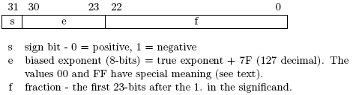

IEEE single precision
IEEE double precision
Notes:
指数(e) 尾数(f, 或叫系数)

Slide 42
Operands for Media and Signal Processing
Vertex
  (x, y, z) + w（重量）to help with color or hidden surfaces
  32-bit floating-point values
Pixel
  (R, G, B, A) Alpha通道：透明度
  Each channel is 8-bit
Notes:
W（重量）一般指颜色，3D绘图，OpenGL,DirectX
Alpha通道：透明度

Slide 43
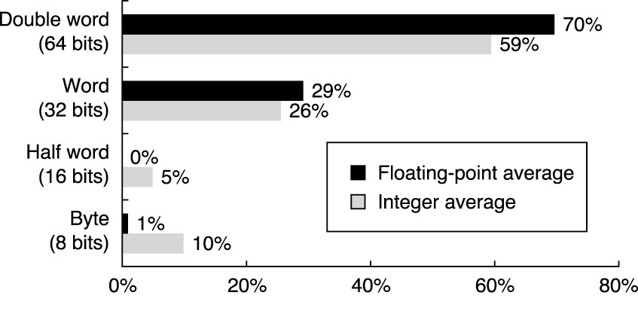
Distribution of Data Access
For SPEC benchmarks

Slide 44
3. Operations in Instruction Sets

Slide 45
What Operations are Needed
Arithmetic and Logical
  Add, subtract, multiple, divide, and, or
Data Transfer
  Loads-stores
Control
  Branch, jump, procedure call and return, trap
System
  Operating system call, virtual memory management instructions
All computers provide the above operations

Slide 46
What Operations are Needed (cont.)
Floating Point
  Add, multiple, divide, compare
Decimal
  Add, multiply, decimal-to-character conversions
String
  move, compare, search
Graphics
  pixel and vertex operations, compression/decompression operations
The above operations are optional

Slide 47
Top 10 Instructions for the 80x86
load: 22%
conditional branch: 20%
compare: 16%
store: 12%
add: 8%
and: 6%
sub: 5%
move register-register: 4%
call: 1%
return: 1%
The most widely executed instructions are the simple operations of an instruction set
The top-10 instructions for 80x86 account for 96% of instructions executed
Make them fast, as they are the common case

Slide 48
4. Instructions for Control Flow

Slide 49
Instructions for Control Flow
Jump
  The change in control is unconditional
Branch
  The change is conditional
Procedure call
Procedure return

Slide 50
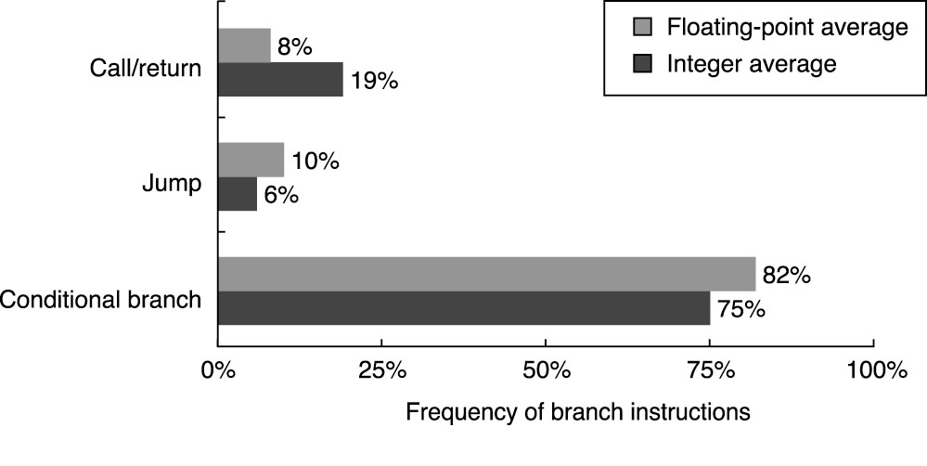
Distribution of Control Flows
Notes:
Load-store计算机上测试

Slide 51
Addressing Modes for Control Flow Instructions
How to get the destination address of a control flow instruction?
  PC-relative
    Supply a displacement that is added to the program counter (PC)
    Position independence 与被载入的位置无关
      Permit the code to run independently of where it is loaded
  A register contains the target address
    case, DLL, Virtual Function…
  The jump may permit any addressing mode to be used to supply the target address
Notes:
与程序运行与加载到的位置无关
虚函数的定义在基类中进行,在需要定义为虚函数的成员函数的声明前冠以关键字 virtual.
基类中的某个成员函数被声明为虚函数后,此虚函数就可以在一个或多个派生类中被重新定义.

Slide 52
Usage of Register Indirect Jumps
Case or switch statements
Virtual functions or methods
High-order functions (function in function) or function pointers
Dynamically shared libraries

Slide 53
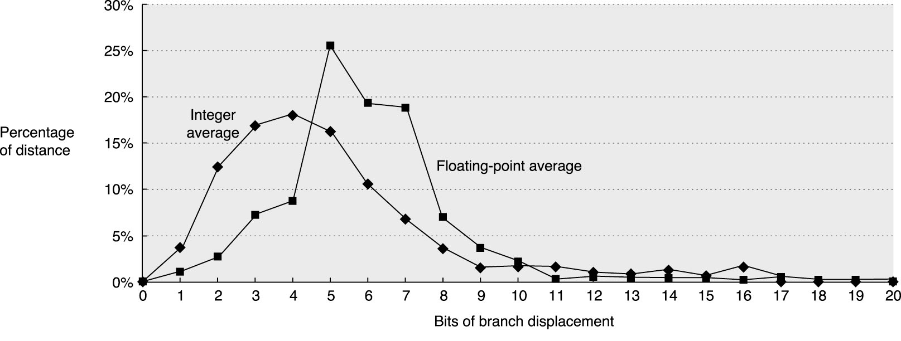
How Far are Branch Targets from Branches?
For Alpha architecture
The most frequent in the integer(相隔4-7条指令). programs are to targets that can be encoded in 4-8 bits
About 75% of the branches are in the forward direction
Notes:
X轴，分支偏移量的位数

Slide 54
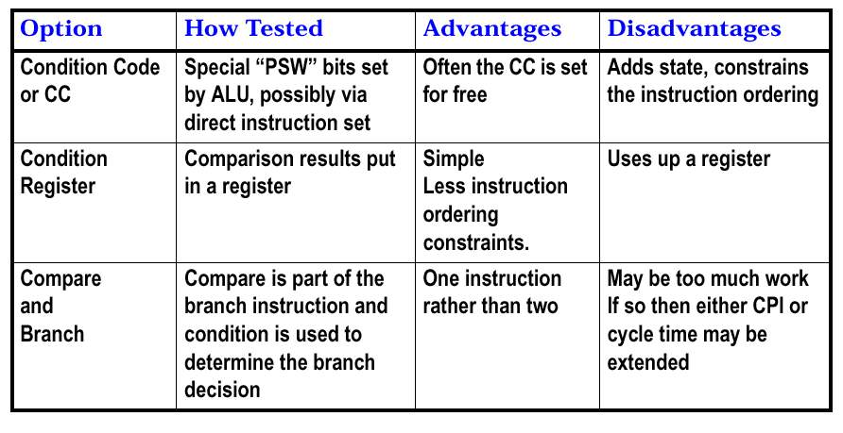
How to Specify the Branch Condition?
Program Status Word
X86: jc xxx
MIPS: jr register
MIPS: beq register1, register2, L1

Slide 55
常用的三种表示分支条件的技术及其优缺点
_{表示分支条件的技术}
_{测试分支条件的方法}
_{优 点}
_{缺 点}
_{条件码（CC）}
_{在程序的控制下，由ALU操作设置特殊的位。}
_{可以自由设置分支条件。}
CC是额外状态，条件码限制了指令顺序，因为必须从一条指令将分支条件信息传送到分支指令。
X86: jc xxx
_{条件寄存器}
_{根据比较结果测试条件寄存器}
_{简单}
_{占用了一个寄存器。}
MIPS: jr register
_{比较且分支}
_{比较操作是分支指令的一部分，通常这种比较是受一定限制的。}
_{一条指令完成了两条指令的功能。}
_{分支指令的操作增多。}
MIPS: beq register1, register2, L1

Slide 56
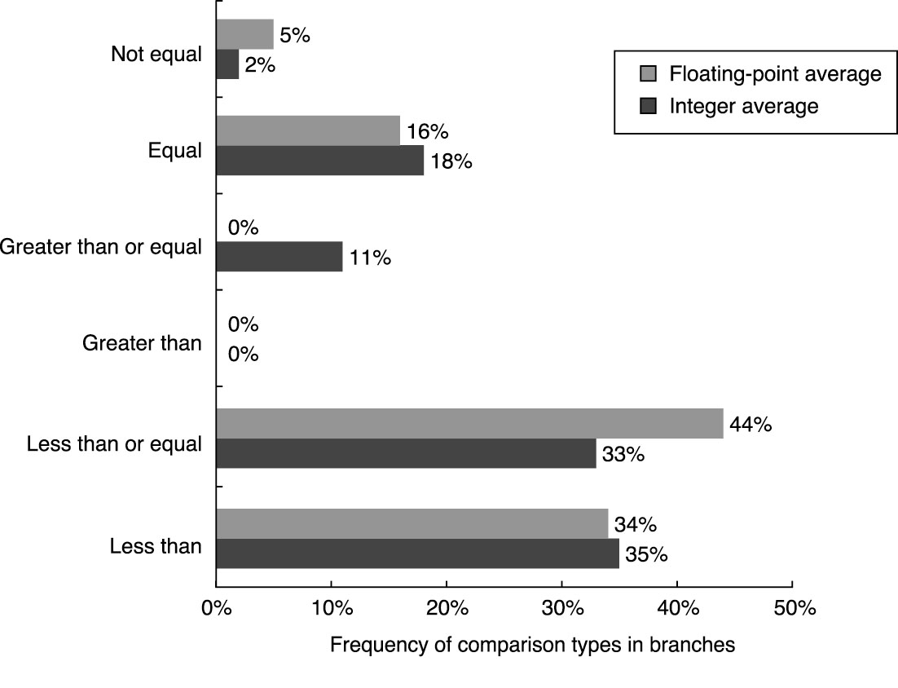
Frequency of Different Types of Compares in Branches

Slide 57
Procedure Invocation Options
The return address must be saved somewhere, sometimes in a special link register or just a GPR
Two basic schemes to save registers
  Caller saving
    The calling procedure must save the registers that it wants preserved for access after the call
  Callee saving
    The called procedure must save the registers it want to use
Notes:
Invocation 调用

Slide 58
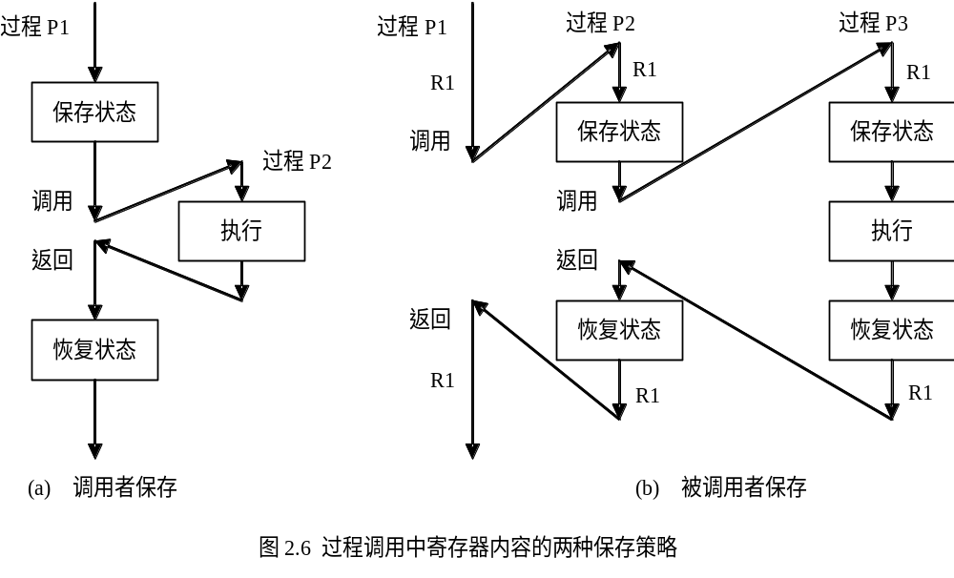
过程调用中寄存器内容的两种保存策略

Slide 59
5. Encoding an Instruction Set

Slide 60
Encoding an Instruction Set
How the instructions are encoded into a binary representation for execution?
  Affects the size of code
  Affects the CPU design
The operation is typically specified in one field, called the opcode
How to encode the addressing mode with the operations
  Address specifier (地址描述符)
  Addressing modes encoded as part of the opcode

Slide 61
Issues on Encoding an Instruction Set
下列因素中找最佳平衡点
Desire for lots of addressing modes and registers
Desire for smaller instruction size and program size with more addressing modes and registers
Desire to have instructions encoded into lengths that will be easy to handle in a pipelined implementation
  Multiple bytes, rather than arbitrary bits
  Fixed-length

Slide 62
3 Popular Encoding Choices
Variable 变长编码
  Allow virtually(事实上) all addressing modes to be with all operations
Fixed 定长编码
  A single size for all instructions
  Combine the operations and the addressing modes into the opcode
  Few addressing modes and operations
Hybrid 混合编码
  Size of programs vs. ease of decoding in the processor
  Set of fixed formats

Slide 63
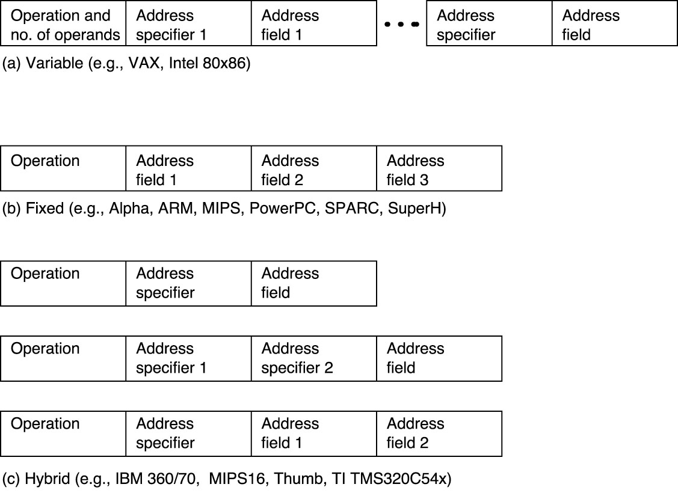
3 Popular Encoding Choices (Cont.)

Slide 64
Summary – Encoding the Instruction Set
Choice between variable and fixed instruction encoding
  Code size than performance -> variable encoding
  Performance than code size -> fixed encoding

Slide 65
Role of Compilers

Slide 66
Compiler vs. ISA
Almost all programming is done in high-level language (HLL) for desktop and server applications
Most instructions executed are the output of a compiler
So, separation from each other is impractical

Slide 67
Goals of a Compiler
Correctness
Speed of the compiled code
Others
  Fast compilation (编译过程)
  Debugging support
  Interoperability among languages
  (可理解为：不同语言编制的不同组件之间的互操作性)

Slide 68
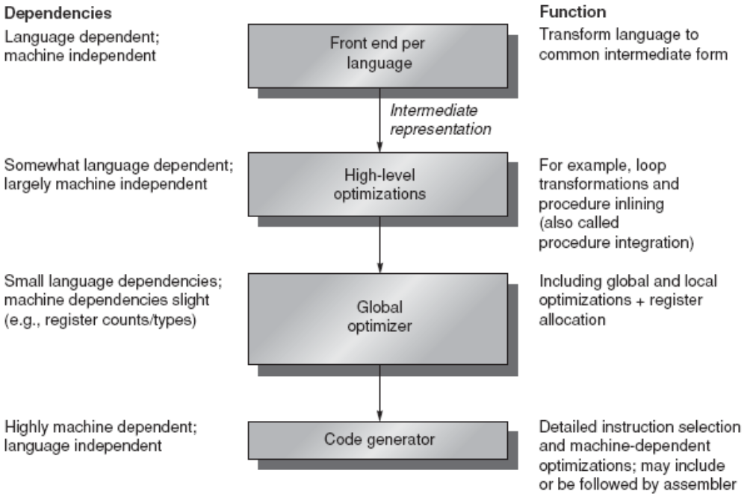
Structure of Recent Compilers
中间形式
循环变换
过程内嵌
集成
全局优化
局部优化+
寄存器分配
指令选择
机器相关优化
Compilers typically consist of two to four passes, with more highly optimizing compilers having more passes.

Slide 69
Structure of Recent Compilers (cont.)
Multi-pass structure 多遍扫描结构
  Easy to write bug-free(无错) compilers
  Make assumptions about the ability of later steps to deal with certain problems （假定后面的步骤有能力处理某些问题：各司其职）
    Phase-ordering problem 相位顺序（优化次序）
      Ex. 1 choose which procedure calls to expand inline before they know the exact size of the it
      Ex. 2 Global common sub-expression elimination
        Find two instances of an expression that compute the same value and saves the result of the first one in a temporary （必须假定会为临时变量分配寄存器）
        Assume a register, rather than memory, will be allocated to save the result
Notes:
compiler optimization modules (called also phases)
to find a sequence s of these phases such that the performance of the final generated program is "optimal" ?

Slide 70
Optimization Types
High level optimizations
  Done on the source
Local optimizations
  Done on basic sequential block (straight-line code)
Global optimizations
  Extend the local optimizations across 跨越branches and loops

Slide 71
Optimization Types (Cont.)
Register allocation
  Use graph coloring (graph theory) to allocate registers 图着色
    NP-complete
    Heuristic algorithm(启发式算法) works best when there are at least 16 (and preferably more) registers
Processor-dependent optimizations
Notes:
NP难题(NondeterministicPolynomialPro-blem),或称为NP完全问题,NP难题很难找到多项式时间的算法
启发式算法是一种能在可接受的费用内寻找最好的解的技术,但不一定能保证所得解的可行性和最优性,甚至在多数情况下,无法阐述所得解同最优解的近似程度。
从最优解的必要条件出发,设计一个有效算法,使之求出的解满足这些必要条件.

Slide 72
Areas in which current high-level languages allocate their data
The stack is used to allocate local variables. The stack is grown or shrunk on procedure call or return, respectively. Objects on the stack are addressed relative to the stack pointer and are primarily scalars (single variables) rather than arrays.
The global data area is used to allocate statically declared objects, such as global variables and constants. A large percentage of these objects are arrays or other aggregate(聚合) data structures.
The heap is used to allocate dynamic objects that do not adhere to a stack discipline. Objects in the heap are accessed with pointers and are typically not scalars.
Notes:
数据部分，进一步又分为两部分：初始化的数据和非初始化的数据；两者均由编译程序分配地址，但前者保存在目标文件中，文件执行时读入内存。后者缺省初值为0，也称bss (Block Started by Symbol) 段，不在目标文件中，文件装入时临时分配内存清0；装入内存后两者不再区分。
BSS段（bss segment）通常是指用来存放程序中未初始化的全局变量的一块内存区域。BSS段属于静态内存分配。
堆栈段（stack segment）包括两部分：
堆（heap）
提供动态内存（通过malloc申请的）。堆在BSS区域的上方，随着程序不断申请内存，堆会向上增长，ps命令显示的进程占用内存的大小也会随之变化。
栈（stack）
也就是维护函数调用的系统栈，函数的参数和本地变量（除去静态变量）储存在这里。栈位于进程内存空间的最高段，并随着函数的调用向下增长。函数回调时，栈向上收回，其中的参数和变量数据作废。

Slide 73
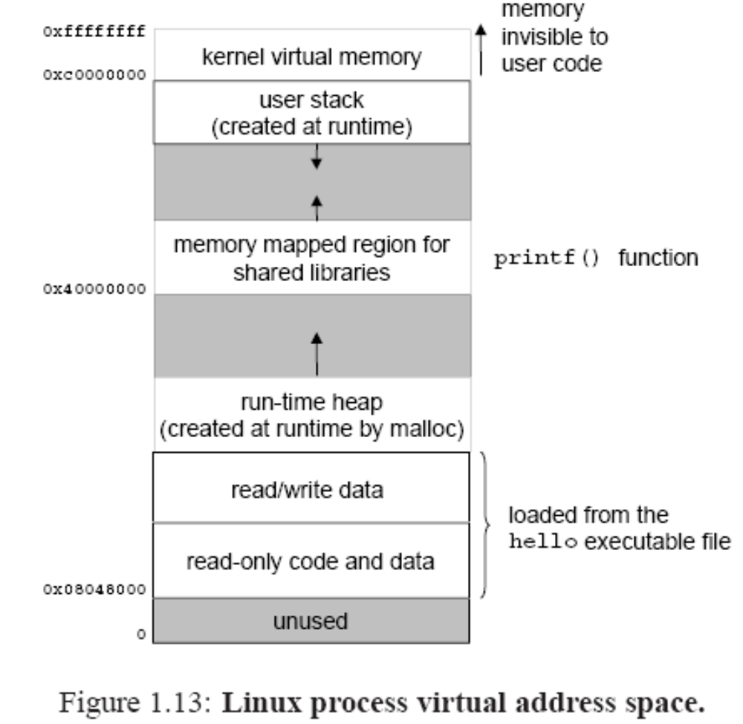

Slide 74
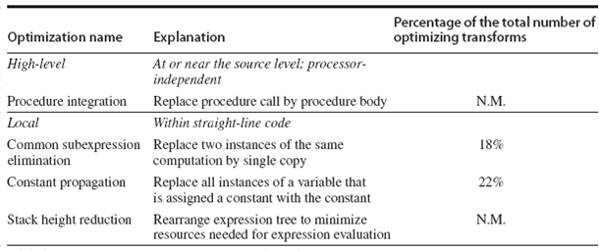
Major Types of Optimizations and Example in Each Class
Notes:
Propagation 传播

Slide 75
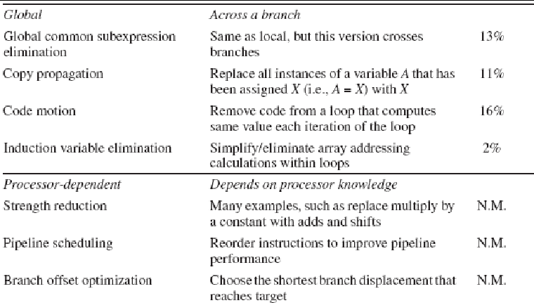
Major Types of Optimizations and Example in Each Class (Cont.)
归纳

Slide 76
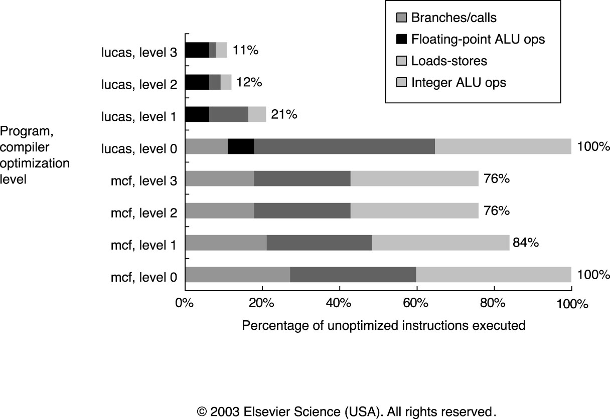
Change in Instruction Count
Due to Compiler Optimization
Level 1: local optimizations, code scheduling, and local register allocation
Level 2: global optimization, loop transformation (software pipelining), global register allocation
Level 3: procedure integration
Notes:
软件流水线技术用来对一个循环结构的指令进行调度安排，使之成为多重迭代循环并行执行。
在软件流水线的运用上，应该尽量使复杂的循环分解成简单的小循环，以避免寄存器的数量不够；对于过于简单的循环，应该适当的展开，以增加代码数量，增加流水线中的迭代指令。
"先展开后调度"技术在进行软件流水线调度之前先展开循环,从而能够发现更多的并行操作和充分利用关键资源.

Slide 77
Optimization Observations
Hard to reduce branches
Biggest reduction is often memory references
Some ALU operation reduction happens but it is usually a few %
Implication:
  Branch, Call, and Return become a larger relative % of the instruction mix
  Control instructions are the hardest to speed up

Slide 78
Impact of Compiler Technology on the Architect’s Decisions
Important questions
  How are variables allocated and addressed?
  How many registers will be needed?
An example
  Variable alias on register allocation
p= &a
a = …
*p = …
…a…
有指针就不分配寄存器

Slide 79
How can Architects Help Compiler Writers
Provide Regularity 规则性
  Address modes, operations, and data types should be orthogonal 正交 (independent) of each other
    Simplify code generation especially multi-pass(多次扫描)
    Counterexample(反例): restrict what registers can be used for a certain classes of instructions
Provide primitives(基本的), not solutions
  Special features that match a HLL construct are often un-usable
  What works in one language may be detrimental (有害的) to others
Notes:
指令集性质会帮助编译器编写者

Slide 80
How can Architects Help Compiler Writers (Cont.)
Simplify trade-offs (简化折中) among alternatives
  How to write good code? What is a good code?
    Metric(度量指标): IC or code size
    (no longer true) →caches and pipeline…
  Help compiler writers understand the costs of alternatives
Provide instructions that bind the quantities known(已知变量) at compile time as constants

Slide 81
Short Summary
An ISA has at least 16 GPR (not counting for FP registers) to simplify allocation of registers
Orthogonality(正交性) suggests all supported addressing modes apply to all instructions that transfer data
Other advices
  Provide primitives instead of solutions
  Simplify trade-offs between alternatives
  Don’t bind constants at run time

Slide 82
The MIPS Architecture
Microcomputer without
Interlocked Pipeline Stages
区分：Millions of Instructions Per Second

Slide 83
MIPS64
A Simple load-store instruction set
Design for pipelining efficiency, including a fixed instruction set encoding
Efficiency as compiler target
Notes:
效率作为编译器的目标

Slide 84
Register for MIPS
32 64-bit integer GPRs (or integer registers)
  R0, R1, ... R31, R0= 0 always
  By convention, each register also has a name to make it easier to code
32 FPRs
  for single (32 bits) or double precision (64 bits)
  F0, F1, ... , F31
Extra status registers
  SR (Status Register), floating-point status register
Other control registers
Notes:
SR（Status Register）寄存器

Slide 85
Registers Conventions for MIPS
0 zero constant 0
1 at reserved for assembler
2 v0 expression evaluation &
3 v1 function results
4 a0 arguments
5 a1
6 a2
7 a3
8 t0 temporary: caller saves
. . . (callee can clobber)
15 t7
16 s0 callee saves
. . . (caller can clobber)
23 s7
24 t8 temporary (cont’d)
25 t9
26 k0 reserved for OS kernel
27 k1
28 gp pointer to global area
29 sp stack pointer
30 fp frame pointer
31 ra return address (HW)
Notes:
Clobber, 重写
CALLEE SAVED
a procedure clears out some registers for its own use
register values are preserved across procedure calls
MIPS calls these saved registers, and designates $s0-s8 for this useage.
$s0-$s8 are aliases for $16-$23, $30
the called procedure saves register values in its AR, uses the registers for local variables, restores register values before it returns.
CALLER SAVED
the calling program saves the registers that it does not want a called procedure to overwrite
register values are NOT preserved across procedure calls
MIPS calls these temporary registers, and designates $t0-t9 for this useage.
$t0-$t9 are aliases for $8-15, $24-$25
procedures use these registers for local variables, because the values do not need to be preserved outside the scope of the procedure.

Slide 86
Data Types for MIPS
8-bit bytes, 16-bit half words, 32-bit words, and 64-bit double words for integer data
32-bit single precision and 64-bit double precision for FP
MIPS64 operations work on 64-bit integer and 32- or 64-bit floating point
  Bytes, half words, and words are loaded into the GPRs with zeros or the sign bit replicated to fill the 64 bits of the GPRs

Slide 87
Addressing Modes for MIPS Data Transfers
Immediate and displacement
  With 16-bit field
Displacement
  Add R4, 100(R1)
  Regs[R4] <- Regs[R4] + Mem[100 + Regs[R1]]
Register-indirect
  Add R4, (R1)
  Regs[R4] <- Regs[R4] + Mem[Regs[R1]]

Slide 88
Addressing Modes for MIPS Data Transfers (cont.)
Absolute addressing
  Using R0 as the base register
  Add R1, (1001)
  Regs[R4] <- Regs[R4] + Mem[1001]
MIPS memory
  Byte addressable with 64-bit address
  Mode selection for Big Endian or Little Endian
  All references between memory and either
  GPRs or FPRs are through loads and stores

Slide 89
MIPS Instruction Format
One instruction is 32 bits
=> divide instruction word into “fields”
  Each field tells computer something about instruction
We could define different fields for each instruction, but MIPS is based on simplicity, so define 3 basic types of instruction formats:
  I-format: for immediate, and lw and sw (since the offset counts as an immediate)
  R-format: for register
  J-format: for jump

Slide 90
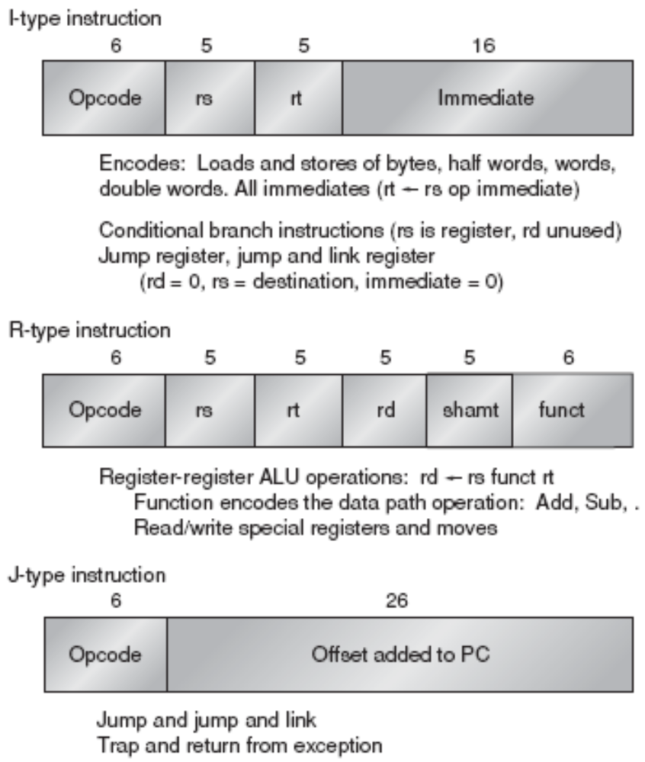
MIPS Instruction Format
Encode addressing mode into the opcode
All instructions are 32 bits with a 6-bit primary opcode
Notes:
register source / register target / register destination

Slide 91
MIPS Instruction Format (Cont.)
I-Type Instruction
6 5 5 16
opcode
rs
rt
Immediate
Loads and Stores LW R1, 30(R2) S.S F0, 40(R4)
ALU ops on immediates DADDIU R1, R2, #3
  rt <-- rs op immediate
Conditional branches BEQZ R3, offset
  rs is the register checked
  rt unused
  immediate specifies the offset
Jump registers, jump and link register JR R3 JALR R3
  rs is target register
  rt and immediate are unused but = 011

Slide 92
MIPS Instruction Format (Cont.)
R-Type Instruction
6 5 5 5 5 6
opcode
rs
rt
rd
shamt
func
Register-register ALU operations: rd←rs funct rt DADDU R1, R2, R3
  Function encodes the data path operations: Add, Sub...
  shamt: contains the amount a shift instruction will shift by.
read/write special registers
Moves
J-Type Instruction: Jump, Jump and Link, Trap and return from exception
6 26
opcode
Offset added to PC

Slide 93
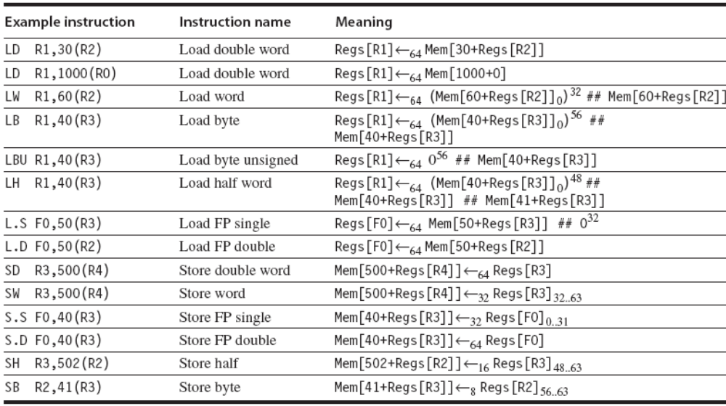
The load and store instructions in MIPS

Slide 94
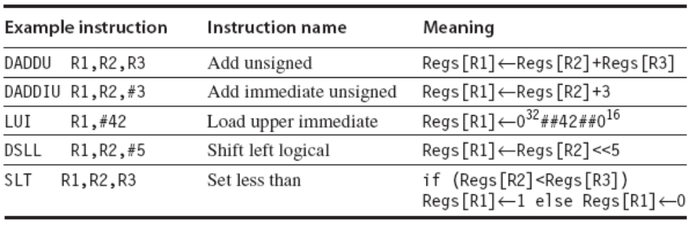
Examples of arithmetic/logical instructions on MIPS

Slide 95
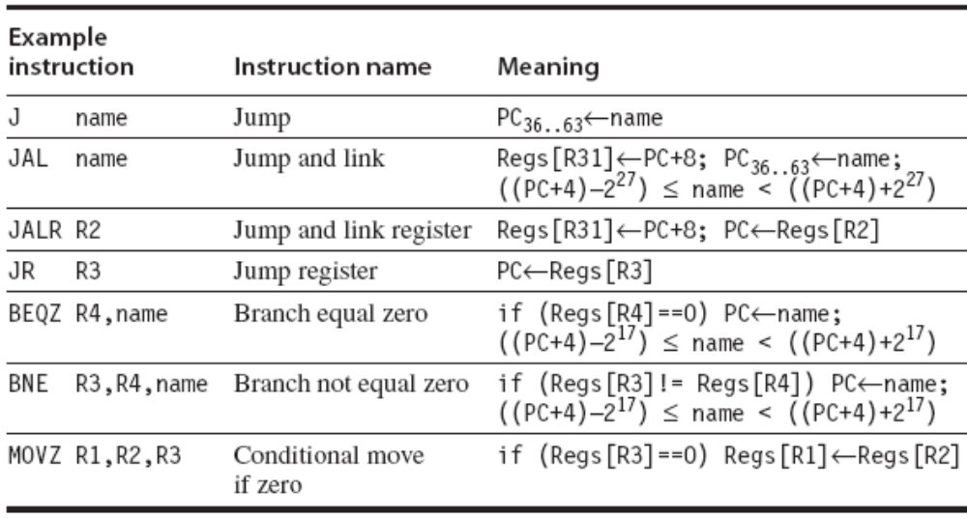
Typical control flow instructions in MIPS
Single instruction to jump and save return address: jump and link (jal)

Slide 96
Subset of the instructions in MIPS64

Slide 97
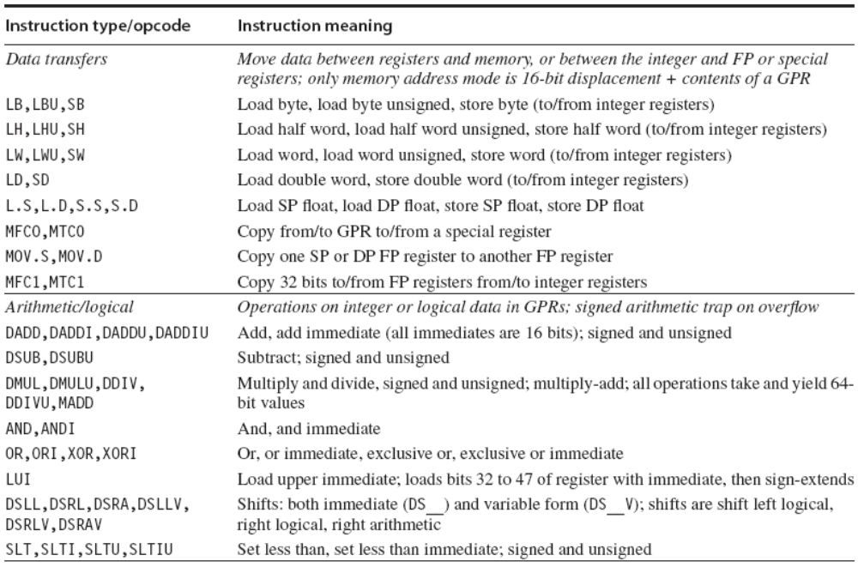

Slide 98
